Slide 1


Bank of Baroda Hackathon - 2022
Technology Partner
Your Team Name : The __Vulnerables__
Your team bio : Heading to a new Era
Date :20:09:2022

Slide 2

Problem Statement?
Why did you decide to solve this Problem statement?
From our experiences, we have seen that filling up bank details has become a hurdle for most users, especially the senior citizens.
We could bring out a possible solution to overcome this hurdle.
A virtual avatar can be created and it works in such a way that it could guide the user to perform the required operations.

Slide 3

Azure tools or resources
Azure tools or resources which are likely to be used by you for the prototype, if your idea gets selected
Azure seams to be more useful for us in this scenario , because it long time to join a course and to accomplish the given task.
As well almost most of the basic course and tutorials we find may or may not be useful to the current situation so it good to go with azure tools.
Azure tools help us in this to handle this type of situation to take action on what we really want , so here azure tools are given priority than others.

Slide 4
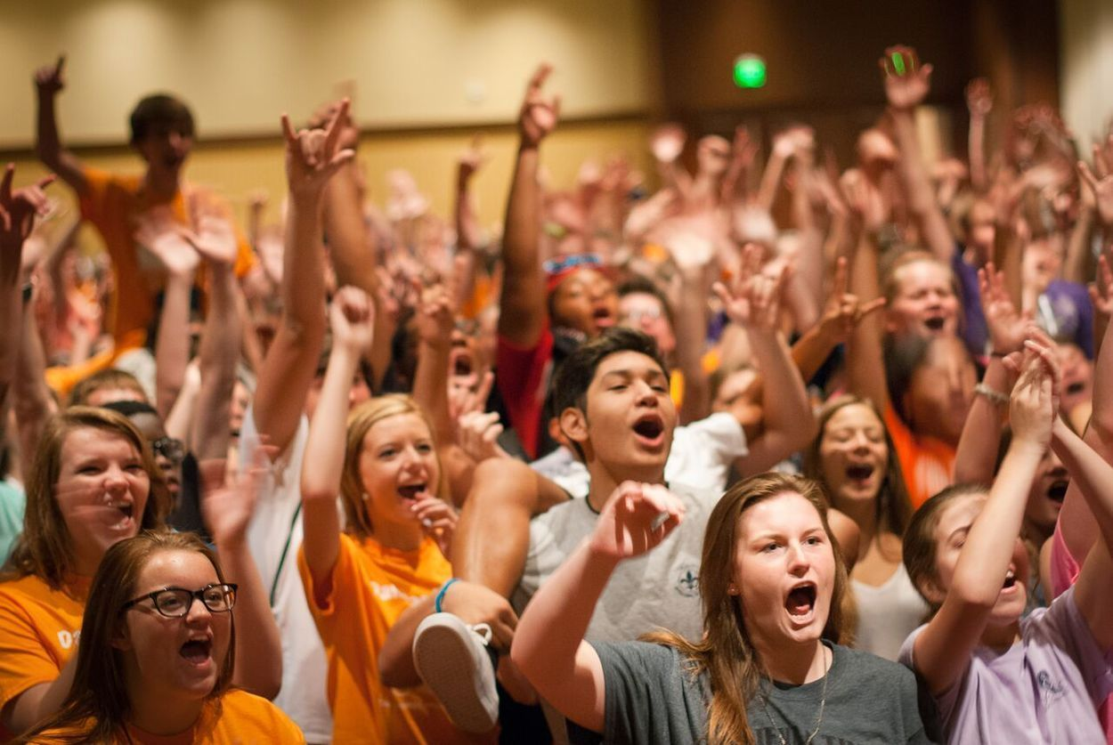
User Segment & Main Points
Which user /advertiser segment would be early adopter of your product & why?
We have an idea of targeting the youngers as well the the middle ages people between the age group (3 0 - 40)
Because nowadays these are the who are taking the small efforts to such an extreme levels.
So choosing this people could be a jackpot for us , In that case these kinds of strategies would us to reach our goal to a great extend.

Slide 5
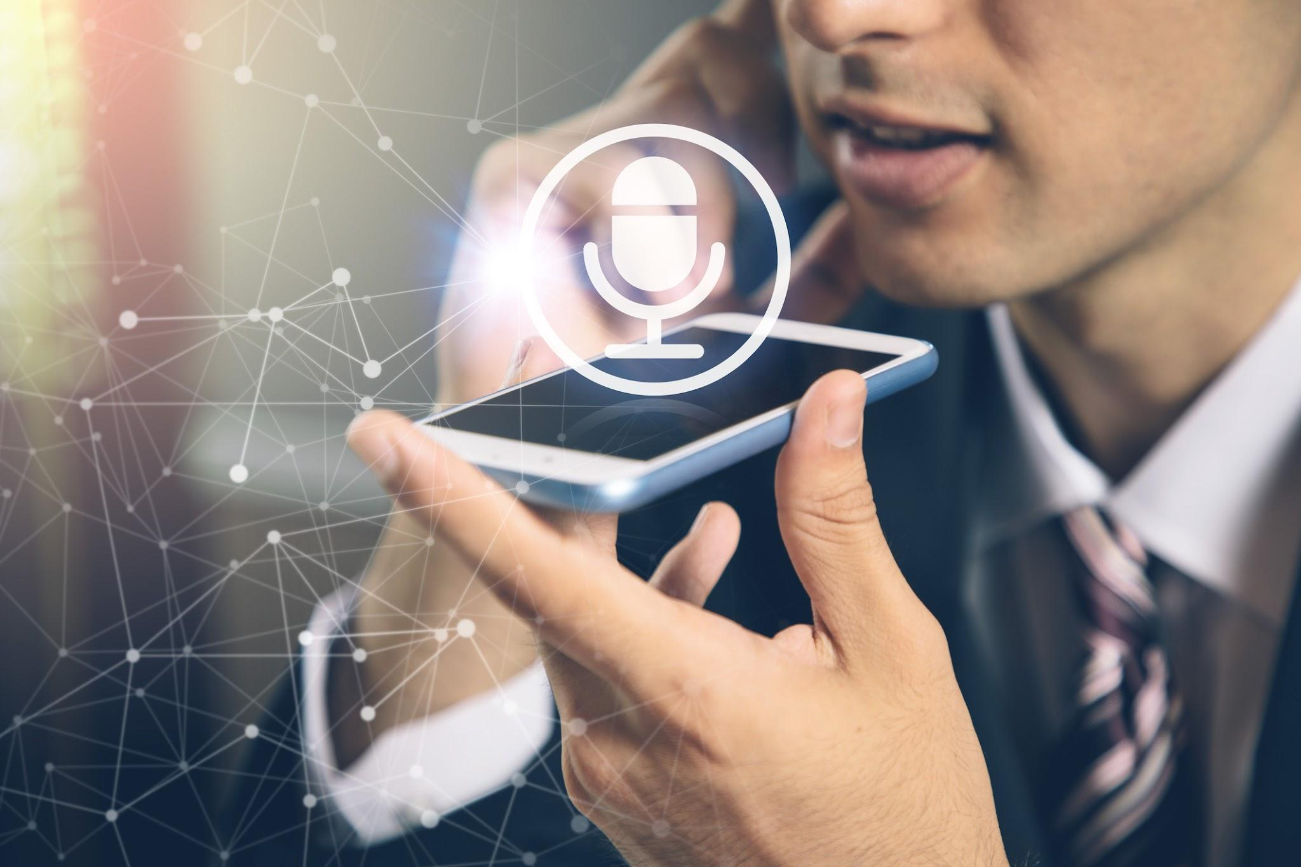
Pre-Requisite
What are the alternatives/competitive products for the problem you are solving?
There are chat bots which does the job. However, they do tend to be a bit difficult to navigate and unreliable.
Adding to this, multilanguage support isn’t available for most chat bots.
Virtual avatars enact some human traits and does could be more effective than that of the chat bots.

Slide 6
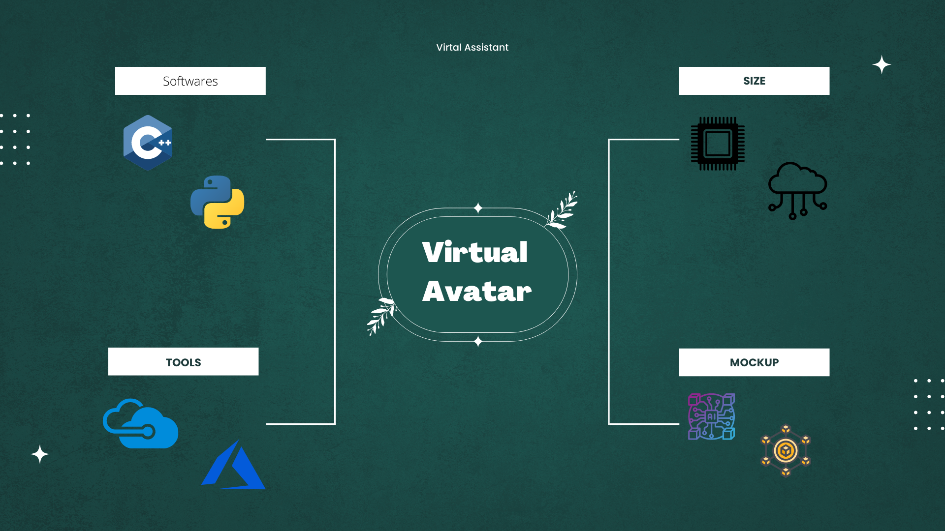
Any Supporting Functional Documents

Slide 7
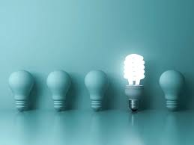
Key Differentiators & Adoption Plan
Our Virtual Avatar is capable of helping people with no English knowledge, The Bot communicate to the user in their native Language
Auto filling already given detail to avoid Redundancy of data
Text to speech functionality for people who are visually challenged.

Slide 8
Thank You…..
Team member names
1. Sriram Aravidh 4. Erick John
2.Shaun Eliot alex
3.Anto Abisheik

